Slide 1
Rural Housing Service
Committed to the Future of Rural Communities

Slide 2
Rural Development -Community Facilities
Direct Loan Program Loan
Guidance Book for Applicants

Slide 3
Rural Development (RD) - Community Facilities
Community Facilities (CF)
This program provides affordable funding to develop essential community facilities. An essential community facility is defined as a facility that provides an essential service to the local community for the orderly development of the community. It must carry out a function customarily provided by a local unit of government. The facility must be located in a rural area and primarily serve rural residents. The facility must be operated on a nonprofit basis and does not include private affairs, commercial or business undertakings (except for limited authority for industrial parks).

Slide 4
Rural Development (RD) - Community Facilities
National Office
Headquarters located in Washington DC | CP Deputy Administrator and staff
State Offices
Located in 47 states | RD State Director and staff
Area Offices
Numbers vary by state | RD Area Director and staff

Slide 5
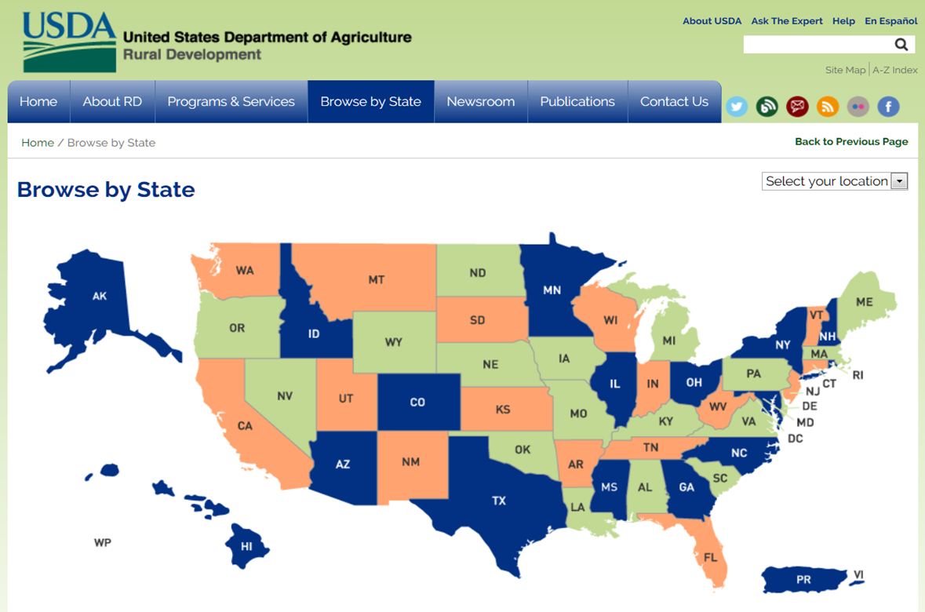
www.rd.usda.gov

Slide 6
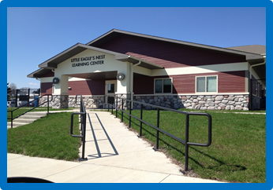
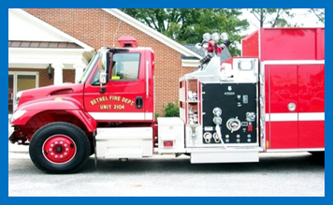
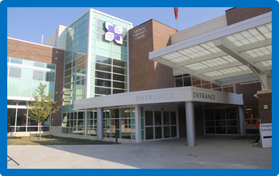
Rural Development (RD) - Community Facilities
Essential Community Facilities
Education & Cultural Facilities & Equipment
Health Care Facilities & Equipment
Public Safety Facilities & Equipment
Public Buildings & Equipment
Infrastructure

Slide 7
Rural Development (RD) - Community Facilities
Eligibility Requirements
    Who May Apply?
    What is an Eligible Rural Area?
    How May Loan Funds be Used?

Slide 8
Rural Development (RD) - Community Facilities
Step 1: The Initial Meeting with Rural Development

Slide 9
Rural Development (RD) - Community Facilities
Initial Meeting with Rural Development
  Discussion on the Key Eligibility Considerations for the Project and the Applicant:
      Eligibility Requirements
        Project
        Applicant
          Organizational Documents
          Most Recent 5 years financial audits
        Location
      Loan
        Current Interest Rates
        Loan Term
          Real Estate
          Equipment
        Debt Service Reserve (DSR) Requirement

Slide 10
Rural Development (RD) - Community Facilities
Initial Meeting with Rural Development (continued)
      Federal Funding Cycle
        Federal Fiscal Year
        Prior Year CF Allocation
      Test for Other Credit
        Availability of Other Credit
      Reimbursable upfront expenditures (construction type projects)
      Interim Financing
        For loans greater than $50,000
      Application Time Table
        Local Office Review Process
        State Office Review Process
        National Office Review

Slide 11
Rural Development (RD) - Community Facilities
Initial Meeting with Rural Development (continued)
      Contracts and Procurement
        Free and Open Competition Requirement
      Financial Feasibility Report (FFR) Requirements
      Environmental Report Requirements
      Security Requirements

Slide 12
Rural Development (RD) - Community Facilities
Eligibility (1942.2(A)(1))
Three Primary Eligibility Requirements
    Entity Type
    Location of the Facility
    Purpose of the Facility

Slide 13
Rural Development (RD) - Community Facilities
Eligible Entities
  Eligible Entities include:
      Nonprofit Corporation
      Public Bodies
      Federally Recognized Tribes

Slide 14
Rural Development (RD) - Community Facilities
Eligible Entities (continued)
  Other Entity Eligibility Requirements
  The Entity must be able to:
      Own the Project;
      Borrower Funds;
      Pledge Collateral;
      Construct;
      Operate;
      Maintain and
      Manage the Project

Slide 15
Rural Development (RD) - Community Facilities
Eligible Locations
  Cities, Towns and Census Designated Places (CDP’s) with population of 20,000 or less
  At least the majority of the population served must be in an eligible rural area
  Project must primarily benefit rural residents and rural communities
  Must be within the jurisdiction of the applicant

Slide 16
Rural Development (RD) - Community Facilities
Eligible Purposes
Construct, expand, renovate, or improve facilities
Acquire existing real estate
Purchase vehicles and major equipment
Associated project expenses (i.e. legal fees, interest expense)
Refinancing when less than 50% of the total project cost

Slide 17
Rural Development (RD) - Community Facilities
Ineligible Purposes
  Funds may not be used to finance:
    Facilities used Primarily for Recreational Purposes
    Commercial Enterprises
    Leased space for ineligible Purposes
    On-Site Utility Systems
    Television Services and Facilities
    Electric Generation and Transmission Facilities
    Telephone Systems

Slide 18
Rural Development (RD) - Community Facilities
Step 2: Pre-Application Meeting

Slide 19
Rural Development (RD) - Community Facilities
Pre-Application submission documents
    Organizational Documents
    SF-424, Application for Federal Assistance
    Most recent 5 years of financial records
    Copies of all existing debt instruments
    Evidence of no other credit being available

Slide 20
Rural Development (RD) - Community Facilities
Pre-Application submission documents
    Organizational Documents
      Public Bodies
        Charter
      Nonprofit Corporations
        Articles of Incorporation
        All amendments
        Bylaws (most recent edition only)
        Certificate of Good Standing
        Charter (if applicable)

Slide 21
Rural Development (RD) - Community Facilities
Audit or Financial Statement Requirements

Slide 22
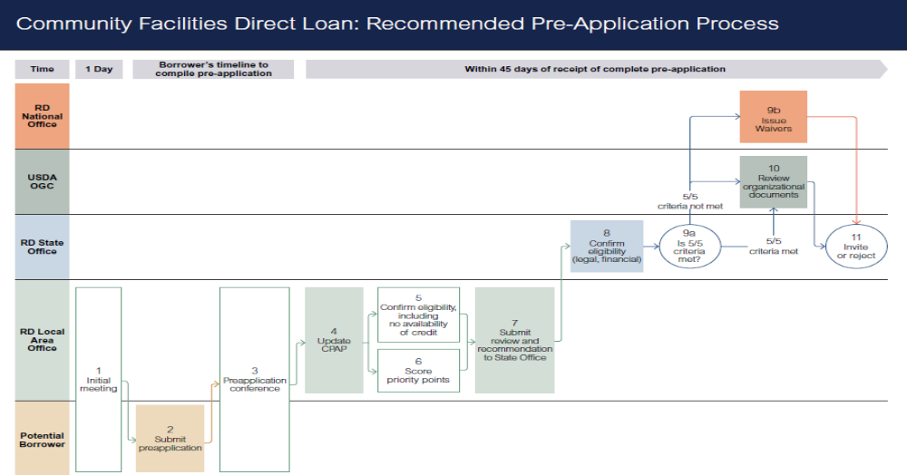

Slide 23
Rural Development (RD) - Community Facilities
Step 3: The Application Process

Slide 24
Rural Development (RD) - Community Facilities Application Process
1. Standard Form (SF) 424, Application for Federal Assistance, accompanied by SF 424A and 424B for non-construction OR SF 424C and 424D for construction.
2. DUNS Number (Dun & Bradstreet Data Universal Numbering System) and Tax ID Number. Guidance is available from Rural Development. (See 7 CFR 1942.2(c)).
3. Organizational Documents
•Public Bodies need to submit a copy of their Charter, all relevant Acts of Assembly, all relevant court orders (if created judicially);
•Corporations need to submit a copy of their signed Articles of Incorporation, Certificate of Incorporation, Amendments, Restatements, Corrections, Mergers, Certificate of Good Standing, and a signed copy of the Corporate By-Laws. If signed copy of the By-Laws is not available, an officer of the corporation (usually the Secretary) must attach a certification that it is a true and correct copy of the current By-Laws. It is HIGHLY recommended to submit these documents prior to submission of the pre-application package.(See 7 CFR 1942.2(a)(1)(v)).
4. Intergovernmental Review comments from local Planning District Commission.
5. System Award Management (SAM) registration at https://uscontractorregistration.com/. The organization must be registered with SAM to be eligible for RD funding.

Slide 25
Rural Development (RD) - Community Facilities Application Process (continued)
Financial Feasibility Report – This report is based on the status of the ownership and cost of the project. Sound financial feasibility reports are essential tools for determining if the applicant has the ability to properly meet its financial obligations. (Refer to the UL "Requirements of Financial Feasibility Evaluations").
7. Preliminary Architectural Report – Use RD Instruction 1942-A, Guide 6, which gives the minimum requirements. (See 7 CFR 1942.18(c)).
•Brief statement describing: (a) how the facility will be operated; (b) the service area [attach maps]; and (c) sources of income.
Copies of outstanding debt instruments (copies of notes, Deeds of Trust, bonds, financing statements/security agreements, and leases, etc.).
Financial Statements for the previous five years. (See 7 CFR 1942.5(b)(1)(ii)(F)).
10. Form RD 442-3, Balance Sheet – Current. (See 7 CFR 1942.5(b)(1)(ii)(E)).

Slide 26
Rural Development (RD) - Community Facilities Application Process (continued)
Form RD 442-7, Operating Budget - Proposed financial projections for the first full year of operation. Include proposed development and first full year of operation. Identify income resources and expense items. With the concurrence of RD, Form RD 1942-52, Cash Flow Projection, may be used for Applicants with annual incomes not exceeding$100,000. Please refer to RD Instruction 1942-A, Guide 15.
A statement regarding efforts to finance the project/facility through other sources.
Form AD-1047, Certification Regarding Debarment; Form AD-1049, Certification Regarding Drug Free Workplace; RD Instruction 1940-Q, Exhibit A-1, Certification Regarding Lobbying; and Form 1910-11, Applicant Certification Regarding Collection Policies, AD 3031, Form 400-1 and Form 400-4.
Statement from State Historical Preservation Officer (SHPO) concerning historical sites and archaeological properties.
15. Agreement for Architectural Services. (See 7 CFR 1942.18(b)).

Slide 27
Rural Development (RD) - Community Facilities Application Process (continued)
Legal Services Agreement. (See 7 CFR 1942.17(I)(1)).
USDA Survey on Ensuring Equal Opportunity for Applicants.
Notice of Public Meeting and Minutes of Public Meeting.
Local Government Letter of Support.
Lease Agreements (If applicable) should be submitted as a draft agreement for review by the RD OGC. This includes all types of leases (ground, space, etc.).
Management Agreements (If applicable) should be submitted as draft agreements for review by the RD OGC.

Slide 28
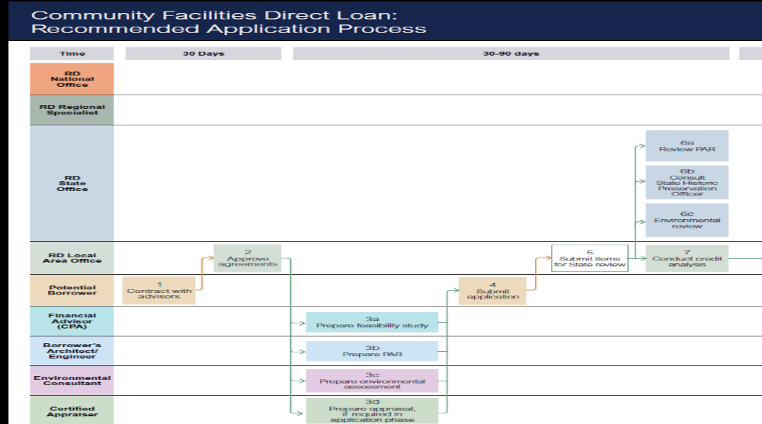

Slide 29
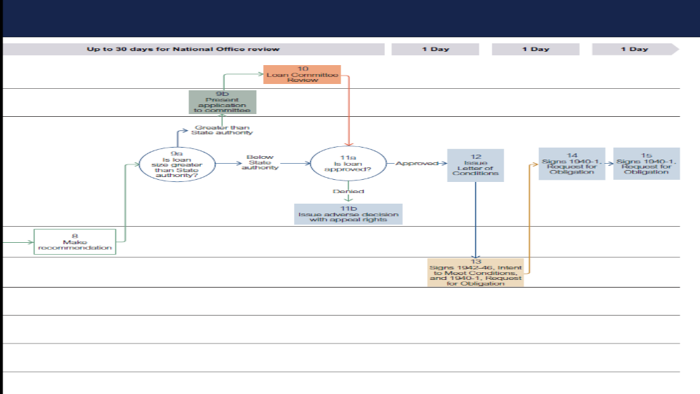

Slide 30
Rural Development (RD) - Community Facilities
Financial Feasibility Requirements
  A financial feasibility report is required for all community facility projects with a loan amount above $500,000. For small loans, a financial feasibility analysis without examination opinion will likely be appropriate

Slide 31
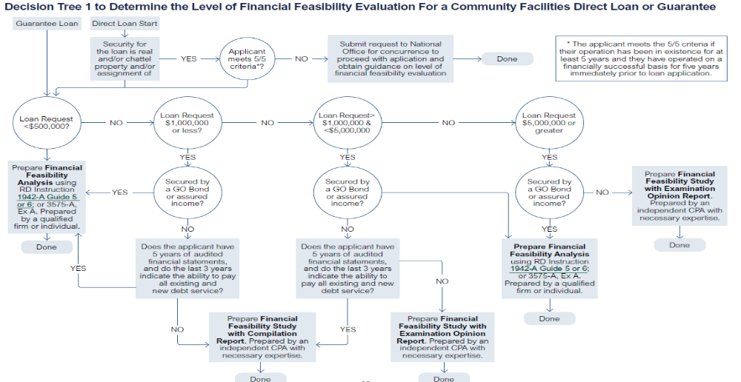

Slide 32
Rural Development (RD) - Community Facilities
Environmental Report Requirements
  For all construction projects, an environmental review is required in accordance with 7 CFR part 1970.
  As a result of the environmental review performed, all environmental mitigation requirements must be considered as the applicant selects the final site and final plans and specifications for the facility.

Slide 33
Rural Development (RD) - Community Facilities
Application Time Table
Key Time Drivers
  Organizational Documents Review
    The local Community Programs Staff should be contacted for assistance with this review.
  Environmental Review Process
  Historic Preservation Process
  Financial Feasibility Reports

Slide 34
Rural Development (RD) - Community Facilities
Borrower hire advisors: architectural, legal, financial, environmental and have RD approve agreements.
Architect/engineer must produce Preliminary Architectural Report (PAR).
Should consult with State Historic Preservation Officer.

Slide 35
Rural Development (RD) - Community Facilities
Collateral
Borrowers must pledge sufficient assets to ensure repayment of the loan. The security may include any combination of the following: real estate, machinery & equipment, assured income, or accounts receivable.

Slide 36
Rural Development (RD) - Community Facilities
Security
Public Bodies
Bonds
      General Obligation (GO)
      Revenue bonds
When bonds are not used: a. Promissory Notes;
      Real Estate Mortgages or Deeds of Trust;
      Financing Statements;
      Security Agreements.

Slide 37
Rural Development (RD) - Community Facilities
Security
Nonprofits
  Promissory Notes (Form RD 440-22);
  Real Estate Mortgages or Deeds of Trust;
  Financing Statements (Form UCC-1);
  Security Agreements (Form RD 1942-9);
    Deposit Agreements;
    Unconditional Guarantees.

Slide 38
Rural Development (RD) - Community Facilities
Security
Tribes
  Assignment of general Tribal income in the form of a Tribal Resolution;
  Lien on specific revenue source generated by the Tribe; i.e., sales tax, fuel tax, gaming revenue (casino);
  Tribal General Obligation Bond.

Slide 39
Rural Development (RD) - Community Facilities
Discussion on Application Best Practices and Lesson Learned
Anita Lopez,
Community Facilities Program
Asset Risk Coordinator

Slide 40
Rural Development (RD) - Community Facilities
Step 4: Closing and Construction

Slide 41
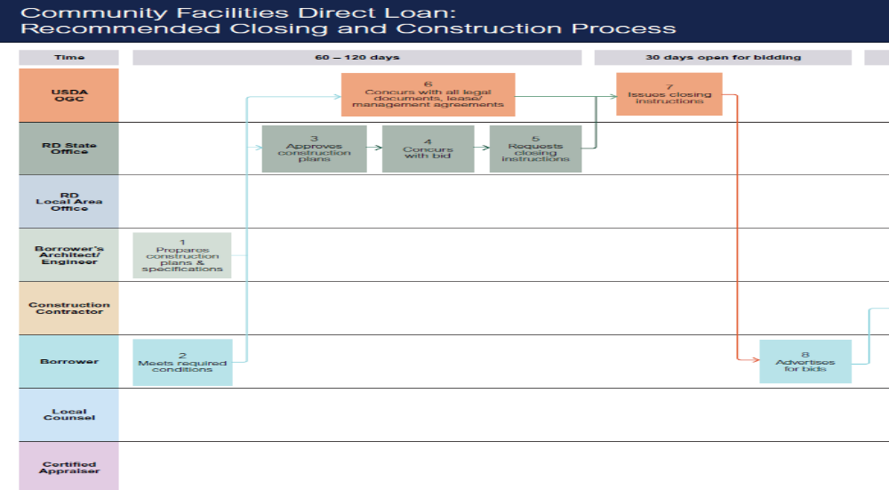

Slide 42
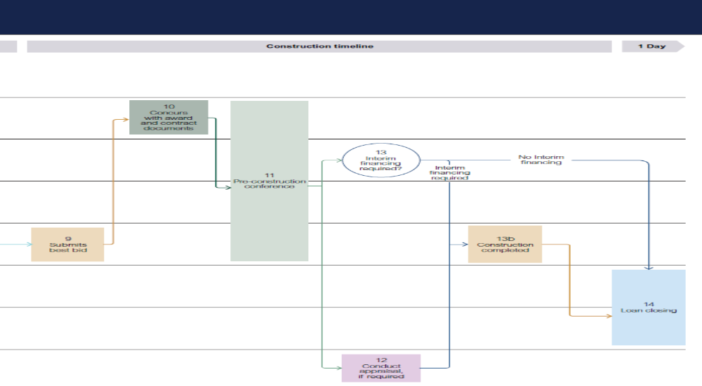

Slide 43
Takeaways:
Primary Eligibility Questions
  Entity
  Location
  Purpose
Legal authority to borrower money.
Facility must serve rural area.
Applicants must be unable to finance the project.
Demonstrate substantial community support.
Financial Feasibility Report
Environmental Review in accordance with NEPA requirements.
Success historical operation (5/5 Criteria)

Slide 44
www.rd.usda.gov

Slide 45
Questions
Perry Hickman
Rural Housing Service
Community Facilities Program
National Office Loan Specialist
1400 Independence Ave., SW
Washington, D.C. 20250
(202) 260-9197

